Slide 1

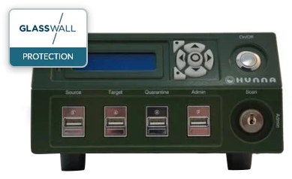
Hunna System USB Santiser
The Hunna System is portable, air-gapped USB sanitiser. Integrated with Glasswall’s Rebuild SDK, it leverages the industry’s leading CDR technology to ensure files and data imported or exported on USB are clean and safe. Built to meet the highest standards of security in the field, the Hunna System delivers military-grade file safety with a simple and intuitive user interface.
Import and export of information on USB media, CD/DVD, SD cards without the risk of infecting receiving information systems
Removes forensic traces of secret information during the import process
Allows for the safe import and sharing of data in any physical environment
Problem
Importing and sharing of data in the field is often done via USB and is inherently risky. Not only does military field work make it difficult to scan files and update anti-virus engines in real time, but the sophisticated nature of threats aimed at defence organisations can often evade these detection-based technologies.
Support for a Wide Range of Disk File Formats
Disk File Formats
AT32, ExFAT, NTFS, EXT4, UDF (DVD), ISO 9660 (CD)
Support for the Most Widley Used File Types
Productivity Files
Microsoft Office OXML (‘03 onwards)
Word
Excel
PowerPoint
Microsoft Office Binary (’97 to ‘03)
Word
Excel
PowerPoint
Adobe Acrobat
Image Files
DOCX, DOTX, DOCM, DOTM
XLSX, XLTX, XLSM, XLTM
PPTX, POTX, PPSX, PPTM, POTM, PPSM
Solution
Developed and deployed with the Swedish Armed Forces, the Hunna System solves this problem. Integrated with Glasswall’s Rebuild SDK, the Hunna System is a portable, air-gapped USB sanitiser that allows users to:
DOC, DOT
XLS, XLT, XLM
PPT, POT, PPS
PDF
JPEG, JPG, JPE, PNG, GIF

Slide 2









How Does it Work?
Hunna uses a scan/copy process that moves data from one USB through
the system and saves the trusted data on another.
Files and documents are scanned though up to five AV engines to search for known malware.
They then undergo complete file regeneration by Glasswall Rebuild, ensuring that all files conform to a standard of ‘known good’.
The safe files are filtered through a whitelist before being copied to a target USB and are signed. The target memory is also signed.
Unknown Content
Vendor 1
Glasswall Engine
Cleaned Files
Copied to USB-target formatted by the Hunna
USB Memory With
Known, Signed Content
Sign Content
USB With
Known Content
Filter Through
Whitelist
Pricing
£10,500
$14,000
Measurements | The device | Device incl packaging
Height | 104 mm | 188 mm
Width | 180 mm | 502 mm
Depth | 328 mm | 400 mm
Weight | 3,5 kg | 7,5 kg
Energy requirements
The Hunna device is powered by an electrical adapter with the output of 19 V 4.74 A.
sales@glasswallsolutions.com
www.glasswallsolutions.com

